Slide 1



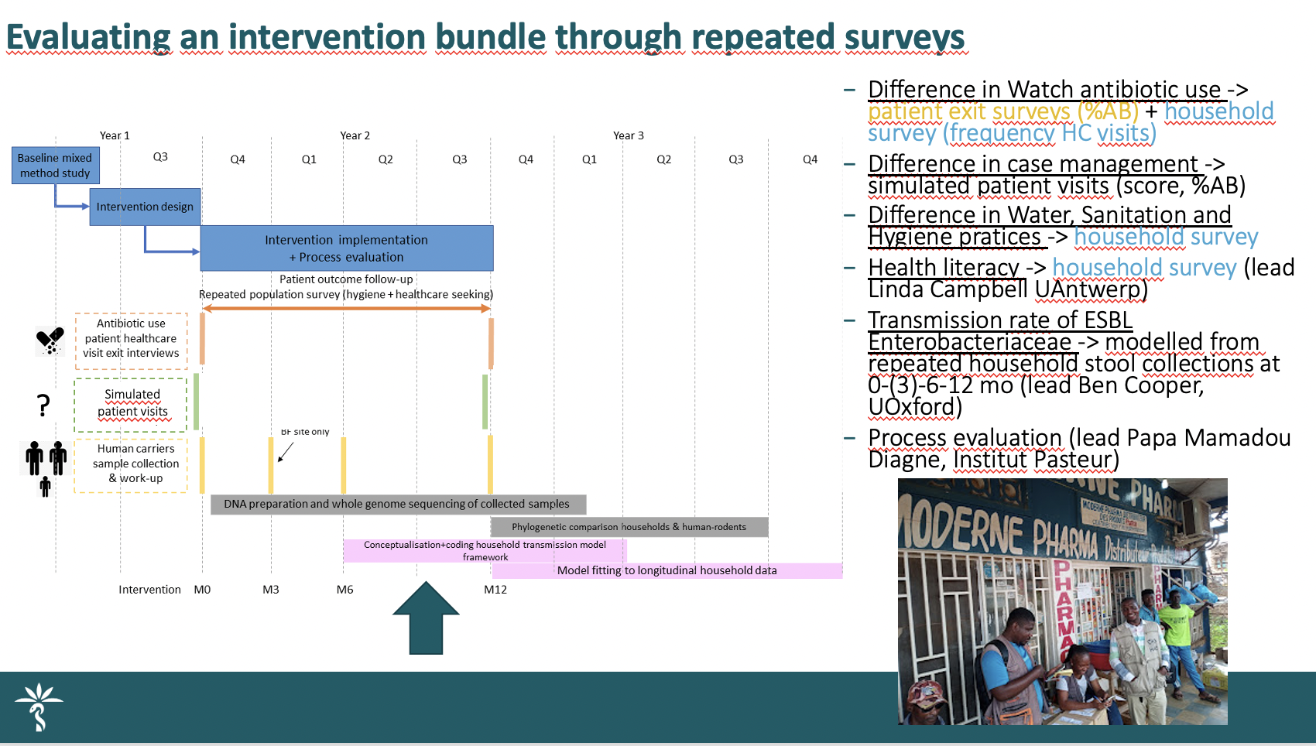
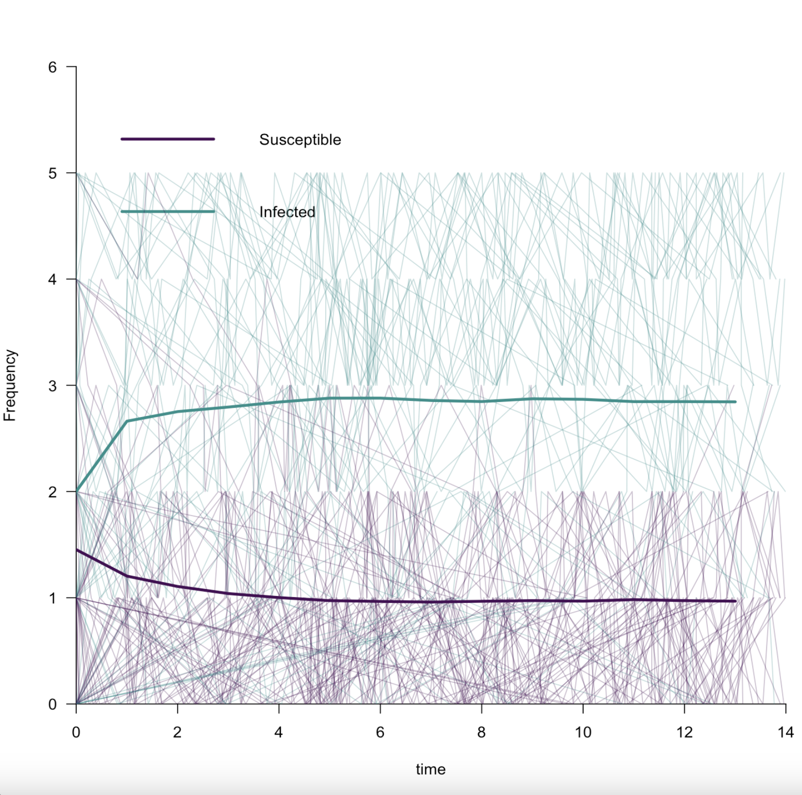
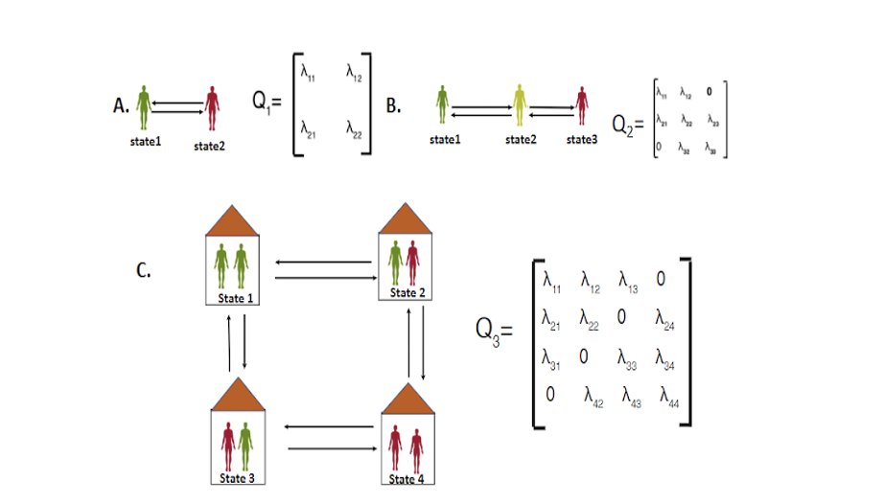
One Health interventions to prevent or reduce the development and transmission of antimicrobial resistance(WORK IN PRGRESS)
Raneem Aizouk, Ben S. Cooper, Esther Van Kleef, Daniel Valia, Linda Campbell, Halidou Tinto, Delphin Mbangi, Djibril Binga, Stéphane Kuando Juste
Centre of Tropical Medicine and Global Health, Nuffield Department of Medicine, University of Oxford, United Kingdom, Institut Médical Evangélique (IME) de Kimpese - Department of Scientific research & Development, Clinical Research Unit of Nanoro (CRUN) - Institut de Recherche en Sciences de la Santé, University Antwerp (UA), Institut Pasteur (IP), Cambridge University, Department of Medicine.
Introduction
Interventions
Antibiotic resistance (AMR) poses a significant threat to low- and middle-income countries (LMICs) [1]. The CABU-EICO project [2] aims to optimise the antibiotic use and infection control at the community level in Burkina Faso by implementing a package of behavioural interventions. We will evaluate the impact of a 12-month behavioural intervention bundle at two sites. In both Burkina Faso (BF) and the Democratic Republic of the Congo (DRC), 22 eligible villages (clusters) will be randomly assigned to either the intervention or no-intervention groups. A total of 132 households per intervention arm will be chosen, with an expected average household size of five. This poster outlines the planned model-based analyses for understanding and combating antibiotic resistance in Burkina Faso and the Democratic Republic of the Congo.
Development of an intervention bundle improving antibiotic use, WASH practices and health literacy Target both supply (dispensers) and demand (population).
Methods
Our study employs a multifaceted approach, utilising different types of data based on the specific objectives:
Data Type | Methodology
Longitudinal Household Data | Primary objectives. Methodology: Leveraging information derived from repeated stool samples over time, we delve into the nuanced complexities of AMR transmission within individual households.
Genomic data(Whole Genome Sequencing – WGS) | Secondary objectives. Methodology: WGS is employed to scrutinize the intricate dynamics of AMR gene transmission across diverse sources in these regions.
Simulation results
Objectives
Primary objective:
Estimate and model the effect of the intervention bundle on AMR transmission, focusing on faecal E. coli carriage.
Secondary objectives:
Quantify (between- and within-)household transmission of AMR genes or pathogens
Estimate the relative importance of an environmental transmission source
Methods
We developed a multi-state Markov model to Estimate and model the effect of the intervention bundle on AMR transmission focussing on E.coli and Salmonella in BF and DRC.
The model uses a Gillespie algorithm to simulate disease spread, allowing for community-level interventions targeting behavioral changes related to antibiotic use and infection control.
In the generated plots, a discernible pattern emerges as we observe the dynamics of infection spread within the simulated household. Initially, there is a notable growth in the number of infectious individuals. However, intriguingly, we observe that this growth eventually reaches a stable level. Simultaneously, the number of susceptible individuals undergoes a decline, eventually plateauing and stabilising. Notably, the infection does not propagate to every individual, suggesting that the disease is persisting at a relatively constant level.
The observed symmetry in the behaviour suggests a balanced interaction between susceptible and infected individuals. The rates of new infections and recoveries are relatively symmetric, contributing to the stability of the system.
The model's performance is quantified using a likelihood function, comparing simulated data with observed values. This study offers valuable insights for designing targeted interventions to mitigate AMR's impact in LMICs.
considering limited genetic information between households. The model uses phenotypic and genotypic data to understand within-household interactions and between-household transmission dynamics.
The model incorporates environmental transmission sources for a holistic understanding of AMR spread. This model enhances its ability to capture real-world dynamics.
Ongoing/Future work
We are preparing and cleaning Longitudinal Household Data for our model, using maximum likelihood techniques to estimate transition rates and incorporating intervention impact into analysis to understand behavioral changes' influence on antibiotic resistance transmission dynamics.
Reference
This work is funded by JPIAMR*/MRC**
*JPIAMR: The joint programming initiative on antimicrobial resistance
**MRC: The medical research council.
[1] Sulis G et al., Expert Rev Anti-Infect Ther. 2022 Feb 1;20(2):147-60.
[2] CABU-EICO Consortium and others, 2023.

